Slide 1
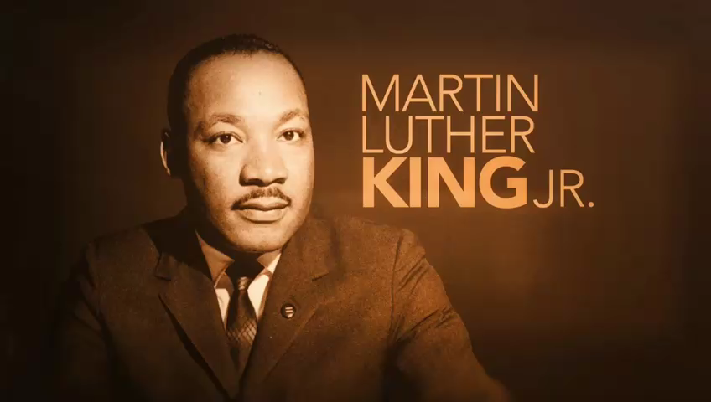
winner, 12 and under
Akshaya Ramanujam
Eden Lake Elementary
My video includes clips on different time periods and aspects of racial discrimination and injustice metted out to people of color in past and present. I have written a poem and voiced the clips.
Which Martin Luther King, Jr. quote are you referencing for your submission?
“Injustice anywhere is a threat to justice everywhere. We are caught in an inescapable network of mutuality, tied by a single garment of destiny. What affects one directly, affects all indirectly.” (April 16, 1963; Letter from Birmingham Jail)

