Slide 1
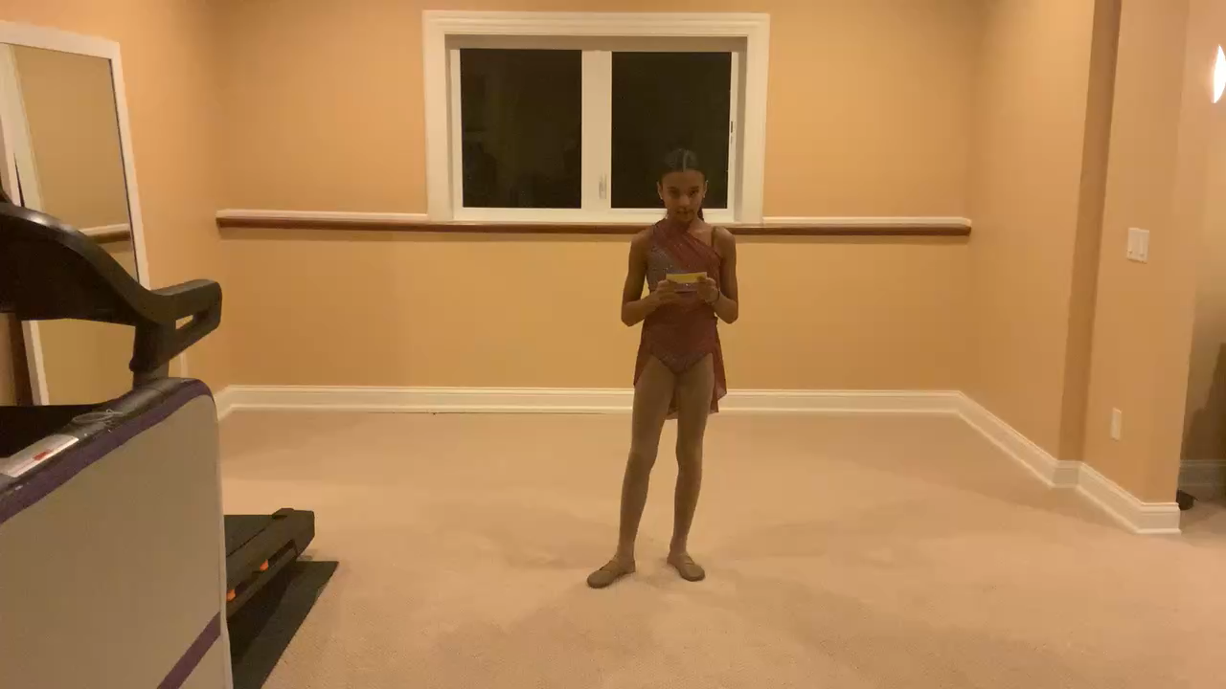

WINNER Amaya Demery Cedar Ridge Elementary
WINNER
Amaya Demery
Cedar Ridge Elementary
Which Black American civil rights leader quote are you referencing?
“I have a dream.
I have a dream that my four little children will one day live in a nation where they will not be judged by the color of their skin but by the content of their character.”
Dr. Martin Luther King, Jr.
1963, at the Lincoln Memorial

